Slide 1
Image Enhancement (Histogram Processing)
Dr. Muhammad Zubair

Slide 2
Image Histograms
The histogram of an image shows us the distribution of grey levels in the image
Massively useful in image processing, especially in segmentation
Frequencies
Grey Levels

Slide 3
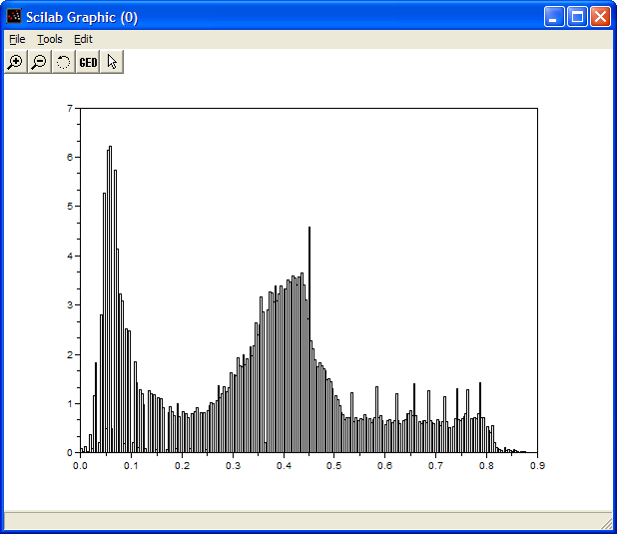
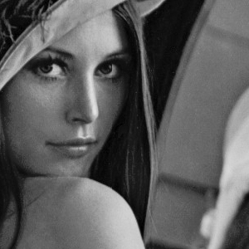
Histogram Examples

Slide 4
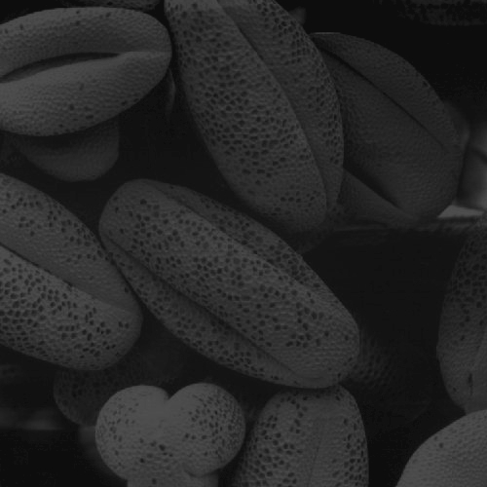
Histogram Examples (cont…)

Slide 5
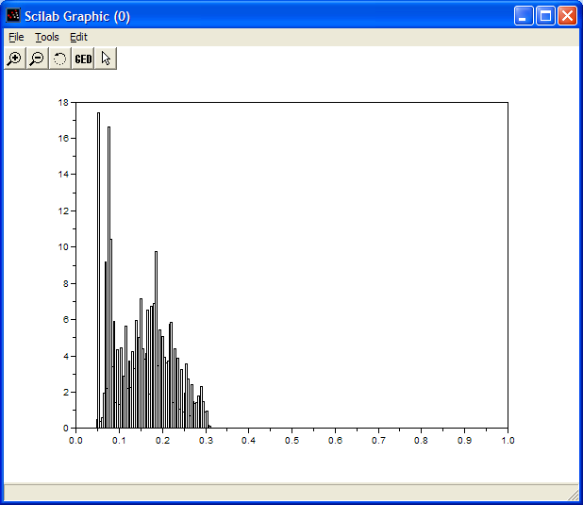
Histogram Examples (cont…)

Slide 6
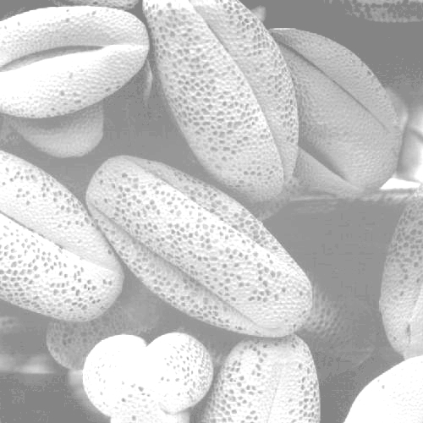
Histogram Examples (cont…)

Slide 7
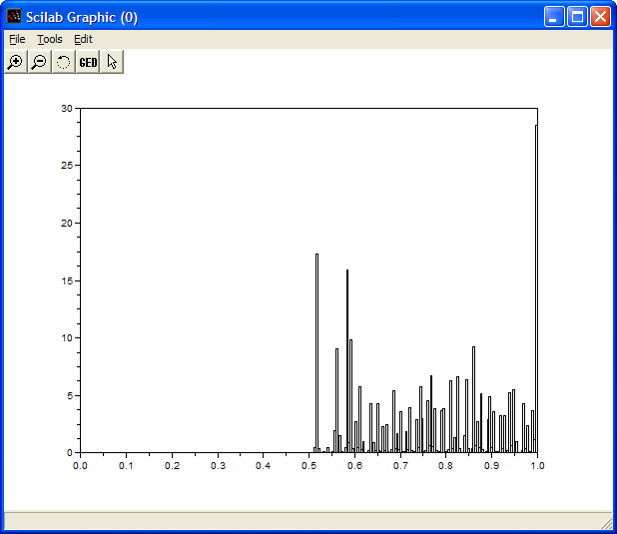
Histogram Examples (cont…)

Slide 8
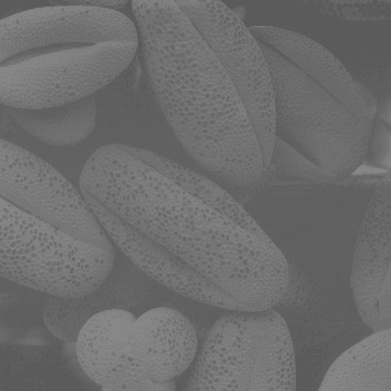
Histogram Examples (cont…)

Slide 9
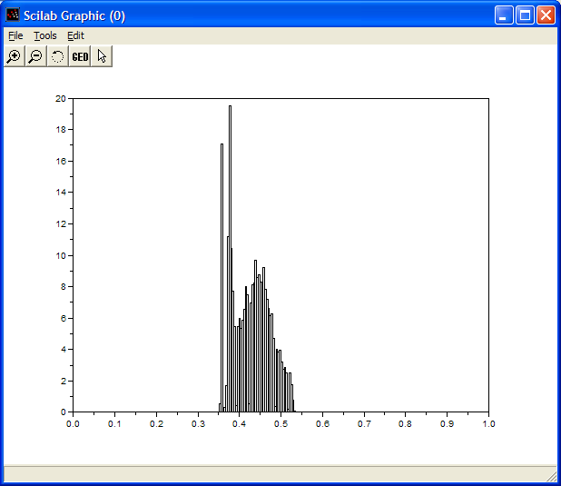
Histogram Examples (cont…)

Slide 10
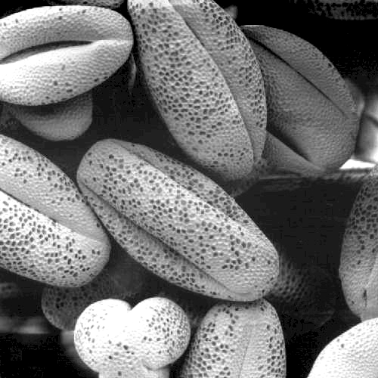
Histogram Examples (cont…)

Slide 11
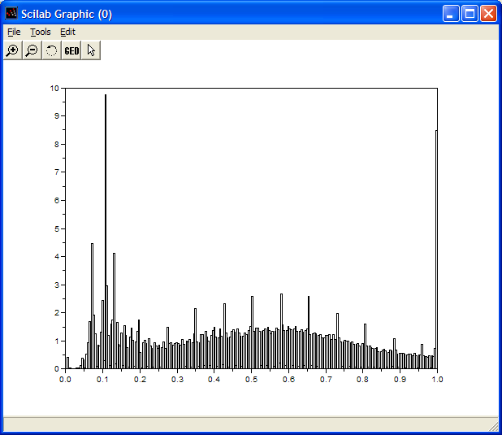
Histogram Examples (cont…)

Slide 12
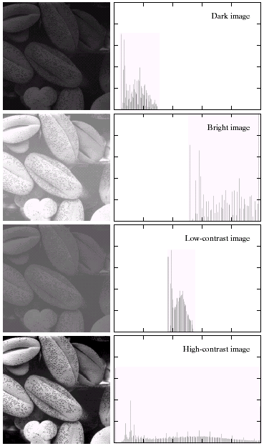
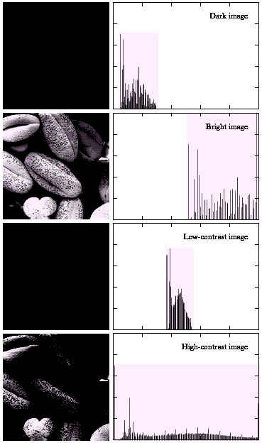
Histogram Examples (cont…)
Notice the relationships between the images and their histograms
Note that the high contrast image has the most evenly spaced histogram

Slide 13
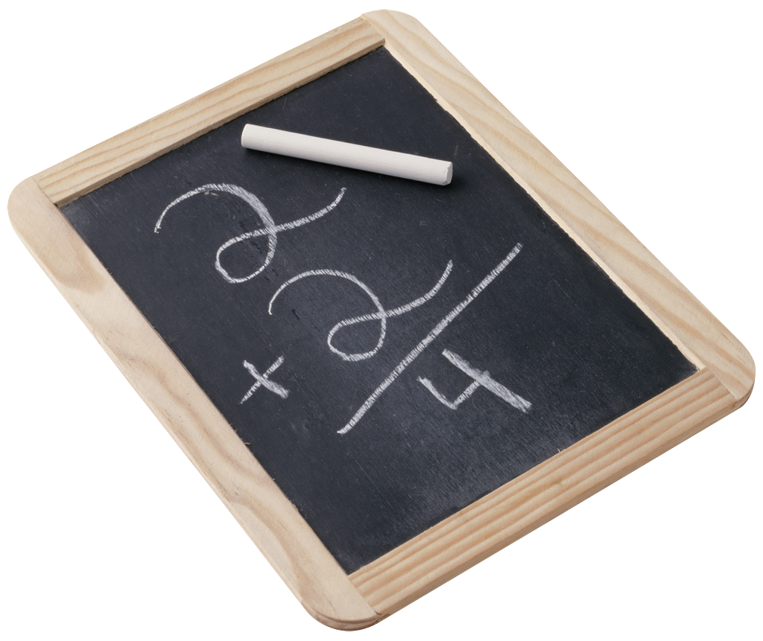
Contrast Stretching
We can fix images that have poor contrast by applying a pretty simple contrast specification
The interesting part is how do we decide on this transformation function?

Slide 14
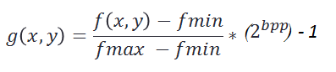
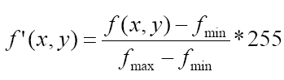
Histogram Stretching
Our aim is to have High Contrast Images
We stretch the Histogram of Images
This is done by the formula:
For an 8bpp image:

Slide 15
Example of Histogram Stretching – 8bpp image
127 | 60 | 60
200 | 127 | 200
127 | 60 | 127
 |  |  |  |  | 4
 |  | 3
 |  |  |  |  |  |  |  | 2
0 |  | 60 |  | 127 |  |  | 200 |  |  | 255

Slide 16
Example of Histogram Stretching – 8bpp image
 |  |  |  |  |  | 4
 | 3
 |  |  |  |  |  |  |  |  |  |  | 2
 | 0 |  |  |  | 122 |  |  |  |  | 255
122 | 0 | 0
255 | 122 | 255
122 | 0 | 122

Slide 17
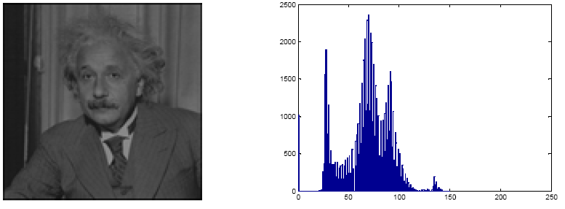
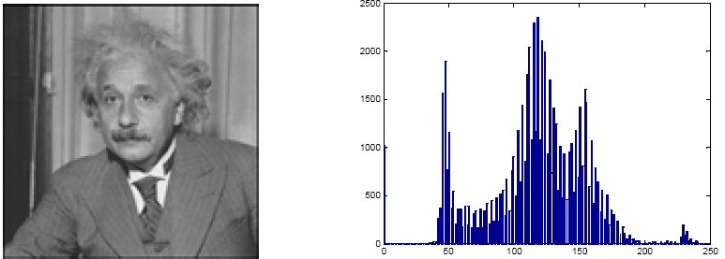
Stretching Histogram of an Image

Slide 18
Problems in Histdogram Stretching
There is no effect of Histogram Stretching on images when:
There are pixels of intensity 0 and intensity 255 in an image.
Extreme Case:
Low Contrast Image
One pixel Intensity = 0
One pixel Intensity = 255

Slide 19
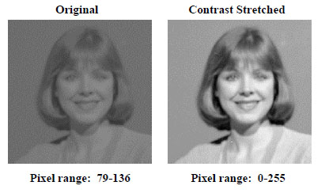
Some Examples of Contrast Stretching

Slide 20
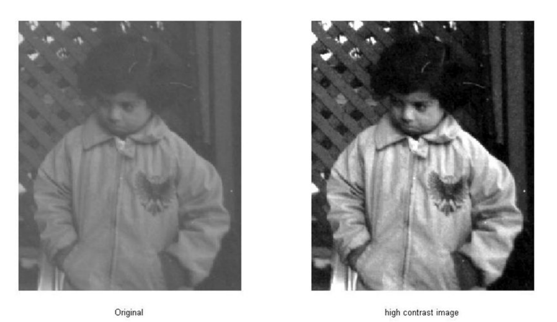
Some Examples of Contrast Stretching

Slide 21
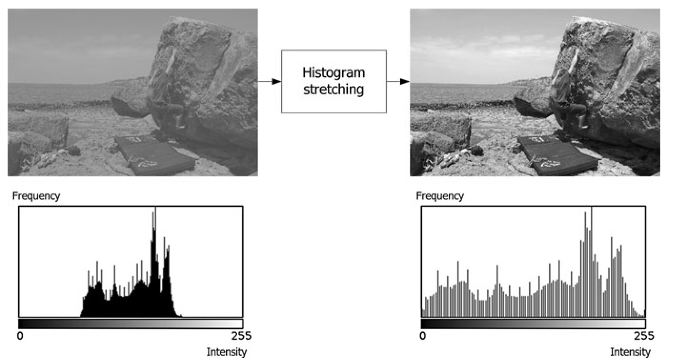
Some Examples of Contrast Stretching

Slide 22
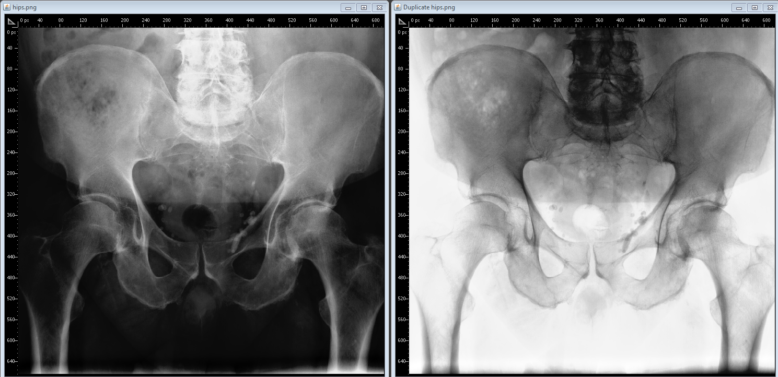
Some Examples of Contrast Stretching

Slide 23
Histogram Equalisation
Spreading out the frequencies in an image (or equalising the image) is a simple way to improve dark or washed out images
The formula for histogram equalisation is given where
r_{k}: input intensity
s_{k}: processed intensity
k: the intensity range (e.g 0.0 – 1.0)
n_{j}: the frequency of intensity j
n: the sum of all frequencies

Slide 24
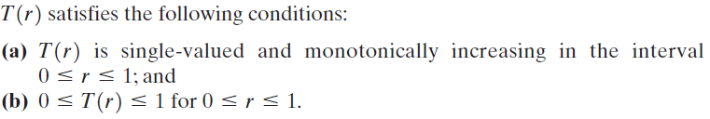
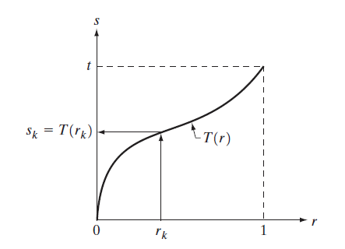
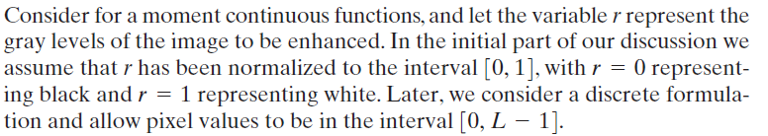
Problem Statement

Slide 25
Preliminaries
PMF (Probability Mass Function)
 |  |  |  |  | 4
 |  | 3
 |  |  |  |  |  |  |  | 2
0 |  | 64 |  | 127 |  |  | 200 |  |  | 255
4/9
0 |  | 64 |  | 127 |  |  | 200 |  |  | 255
3/9
2/9

Slide 26
Preliminaries
CDF (Cumulative Distribution Function)
1
 | 0 |  | 64 |  | 127 |  |  | 200 |  |  | 255
7/9
3/9

Slide 27
Example
Assume a 3-bit image with the following histogram information:
 |  |  |  |  | 14
 | 10
 |  |  | 9
 |  | 8
 |  |  |  |  |  |  | 5
 |  |  |  | 2 |  |  |  | 2
 |  |  |  |  |  | 1
 | 0 | 1 | 2 | 3 | 4 | 5 | 6 | 7
Gray Level Value | No. of Pixels
0 | 10
1 | 8
2 | 9
3 | 2
4 | 14
5 | 1
6 | 5
7 | 2

Slide 28
Step 1 – Calculate PMF
Total Number of Pixels = 51
Gray Level Value | PMF
0 | 10 ÷ 51 = 0.196
1 | 8 ÷ 51 = 0.156
2 | 9 ÷ 51 = 0.176
3 | 2 ÷ 51 = 0.039
4 | 14 ÷ 51 = 0.274
5 | 1 ÷ 51 = 0.020
6 | 5 ÷ 51 = 0.100
7 | 2 ÷ 51 = 0.039

Slide 29
Step 2 – Calculate CDF
Gray Level Value | PMF
0 | 0.196
1 | 0.156
2 | 0.176
3 | 0.039
4 | 0.274
5 | 0.020
6 | 0.100
7 | 0.039
CDF
0.196
0.352
0.532
0.567
0.841
0.861
0.961
1

Slide 30
Step 3 – CDF x (Levels – 1)
Gray Level Value | PMF
0 | 0.196
1 | 0.156
2 | 0.176
3 | 0.039
4 | 0.274
5 | 0.020
6 | 0.100
7 | 0.039
CDF
0.196
0.352
0.532
0.567
0.841
0.861
0.961
1
CDF x 7
1.37 = 1
2.47 = 2
3.72 = 4
3.97 = 4
5.88 = 6
6.02 = 6
6.72 = 7
7

Slide 31
Step 4 – Map Gray Levels
The (CDF x 7) found in the last step were the new Gray Level Intensities.
Gray Level Value | No. of Pixels
0 | 10
1 | 8
2 | 9
3 | 2
4 | 14
5 | 1
6 | 5
7 | 2
New Gray Level Values
1
2
4
4
6
6
7
7

Slide 32
Equalized Histogram
15
Gray Level Value | No. of Pixels
1 | 10
2 | 8
4 | 9
4 | 2
6 | 14
6 | 1
7 | 5
7 | 2
 |  |  |  | 11
 | 10
 |  | 8
 |  |  |  |  |  |  | 7
0 | 1 | 2 | 3 | 4 | 5 | 6 | 7

Slide 33
Steps of Histogram Equalization
Calculate PMF
Calculate CDF
Multiply CDF by gray level resolution – 1 (levels – 1)
Map New gray level values to number of pixels

Slide 34
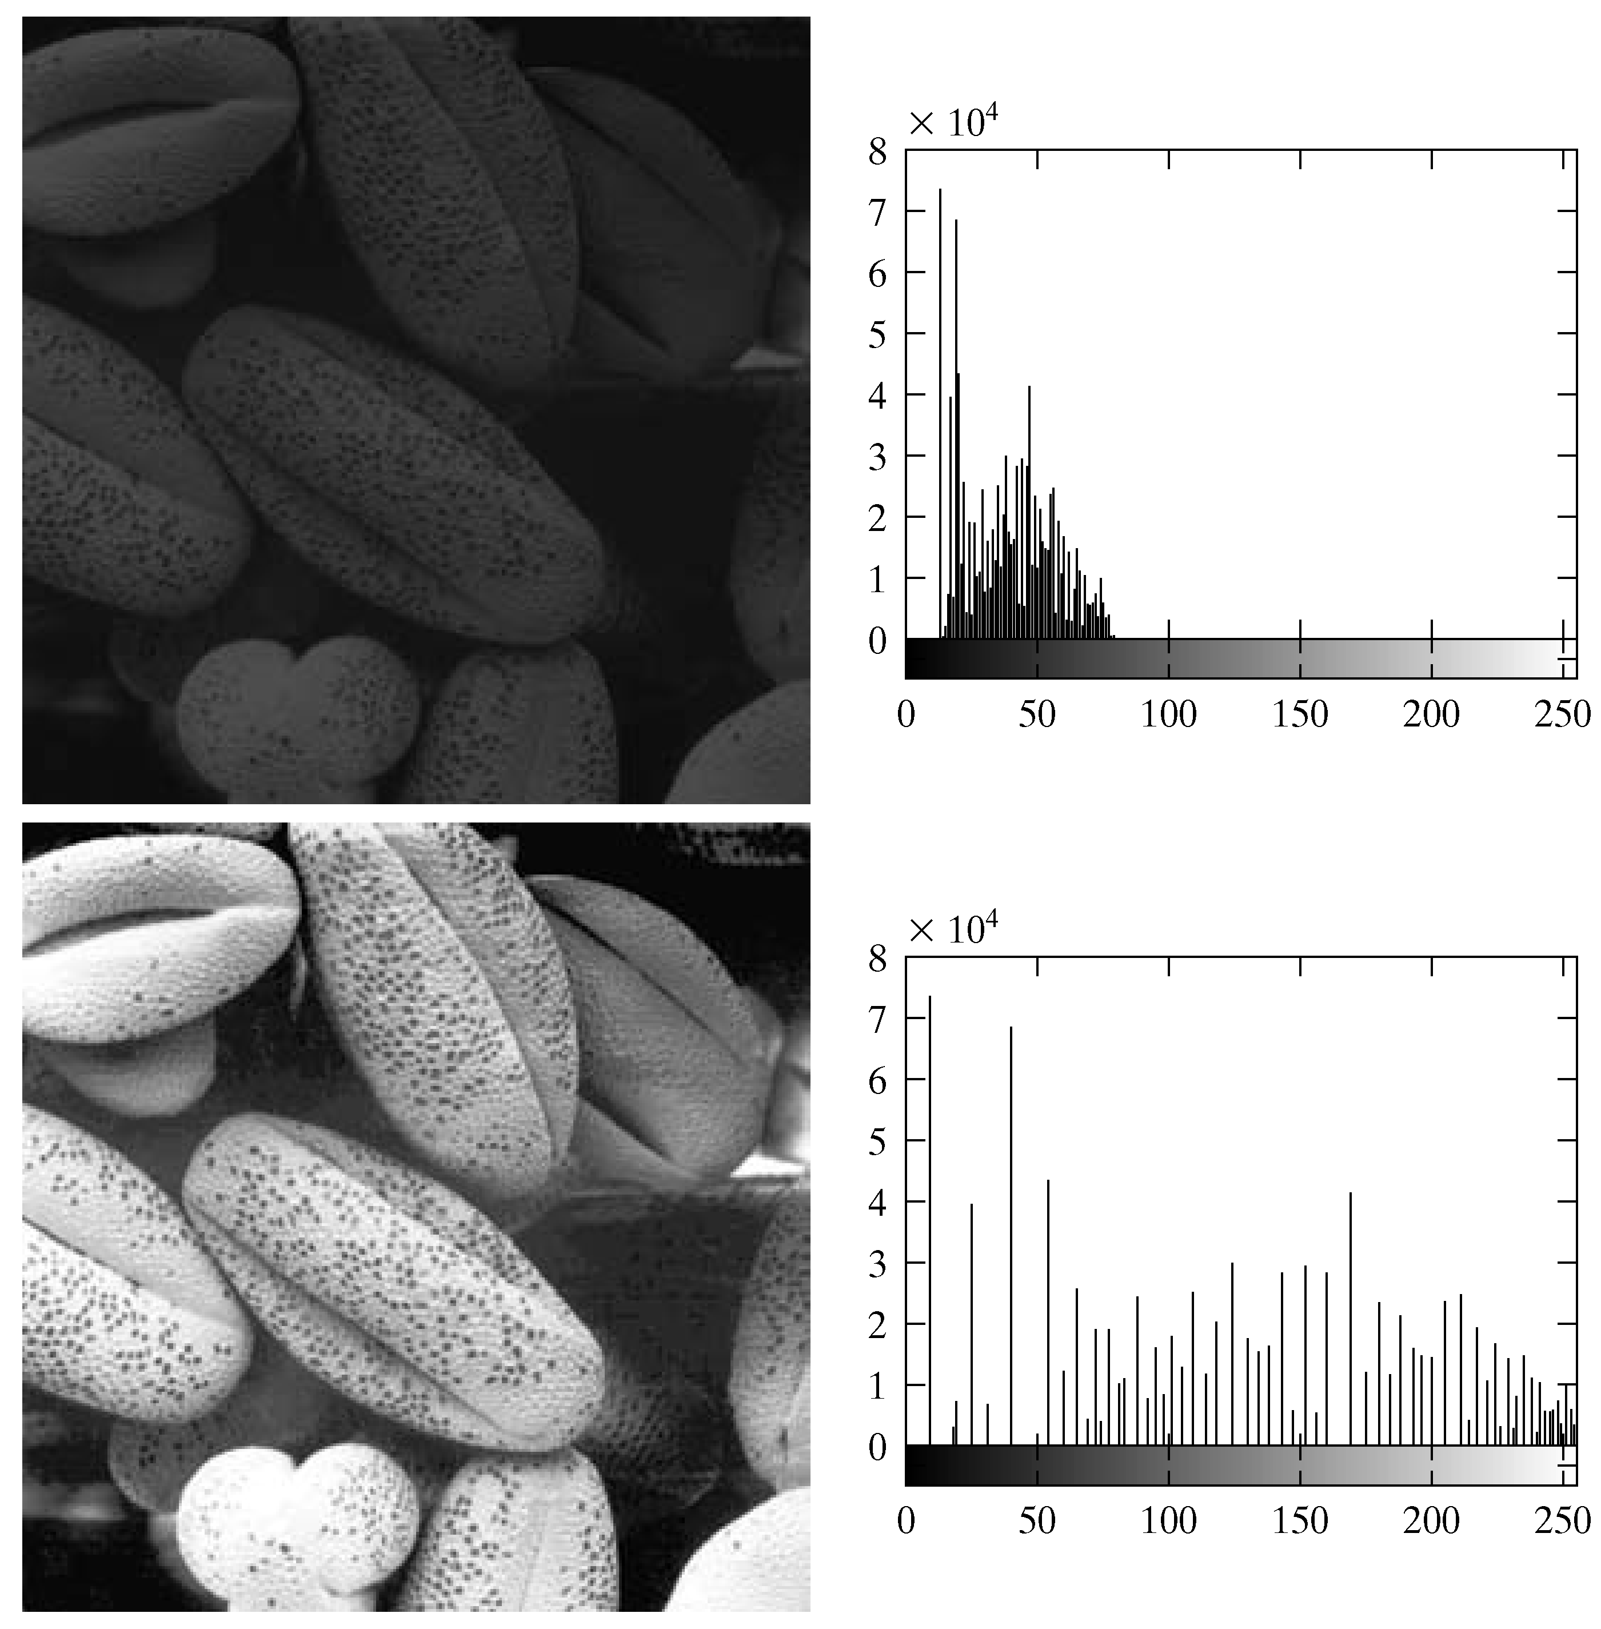
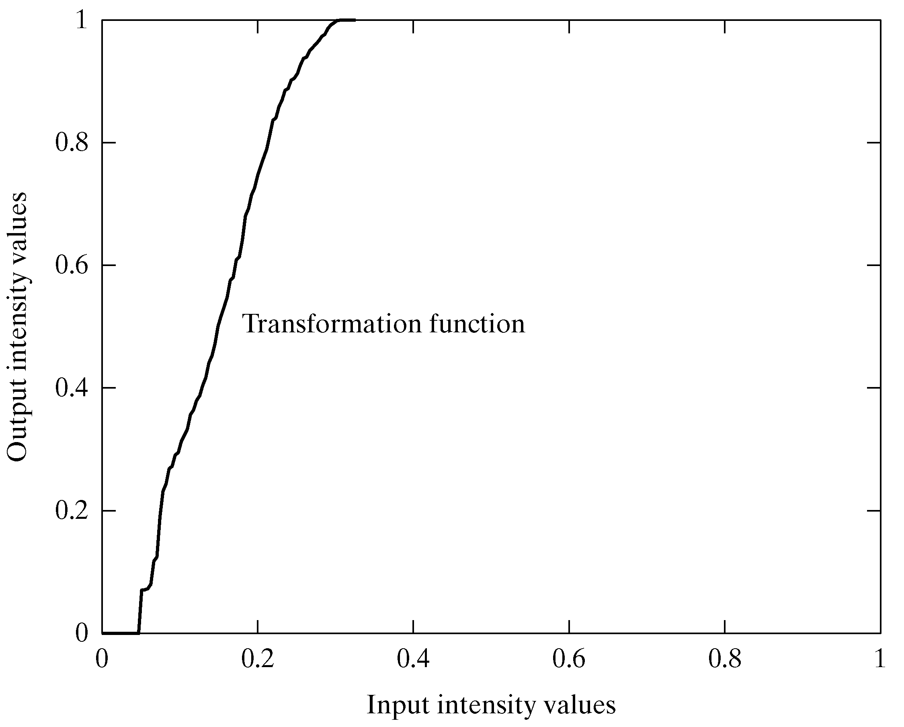
Equalization Transformation Function

Slide 35
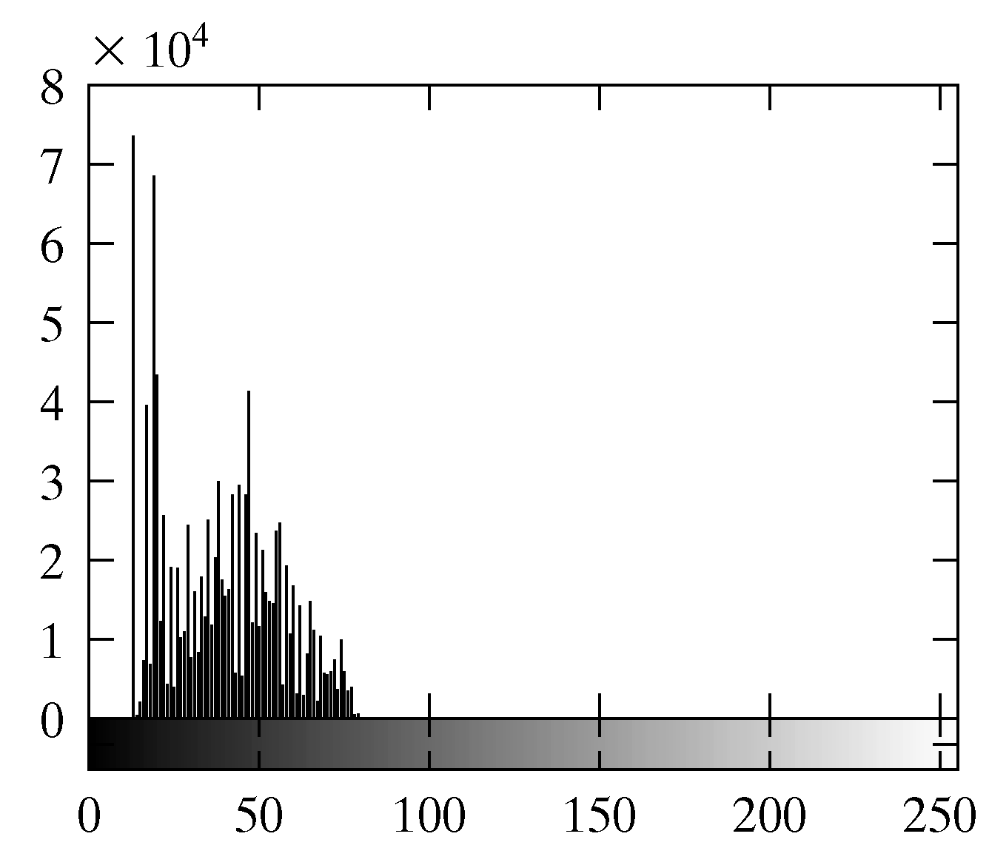
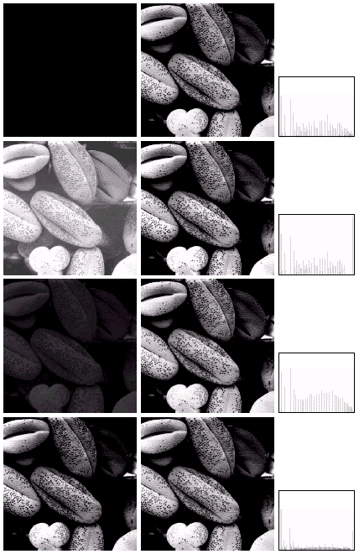
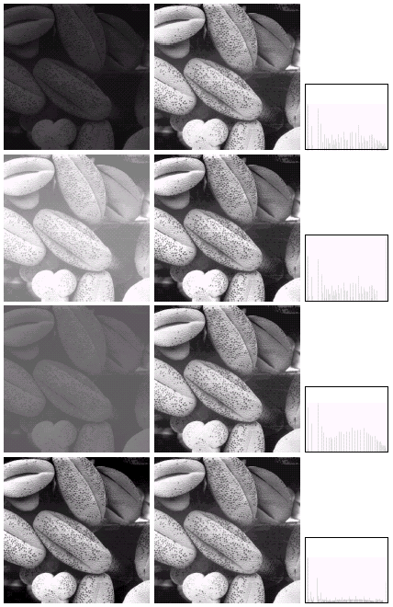
Equalization Examples
1

Slide 36
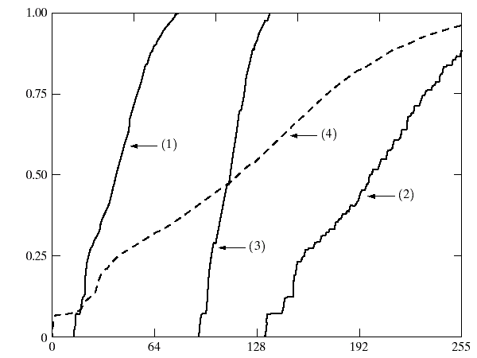
Equalization Transformation Functions
The functions used to equalise the images in the previous example

Slide 37
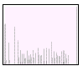
Equalization Examples
2

Slide 38
Equalization Transformation Functions
The functions used to equalise the images in the previous example

Slide 39
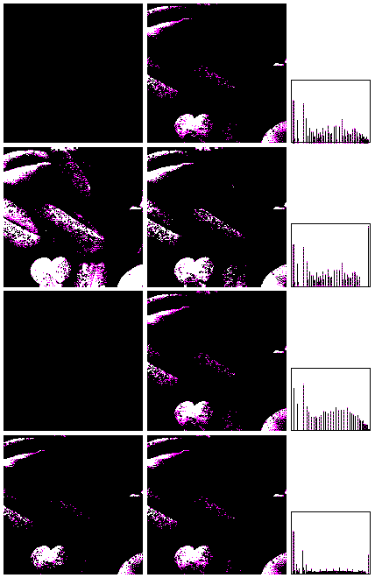
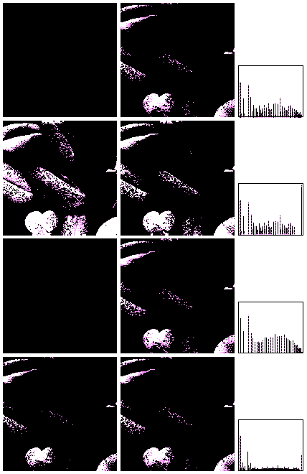
Equalization Examples (cont…)
3
4

Slide 40
Equalization Examples (cont…)
3
4

Slide 41
Equalization Transformation Functions
The functions used to equalise the images in the previous examples

Slide 42
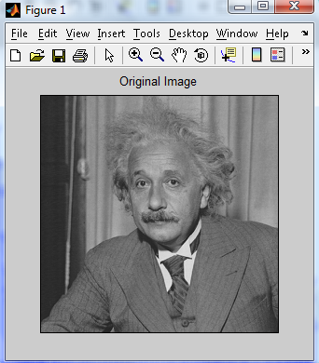
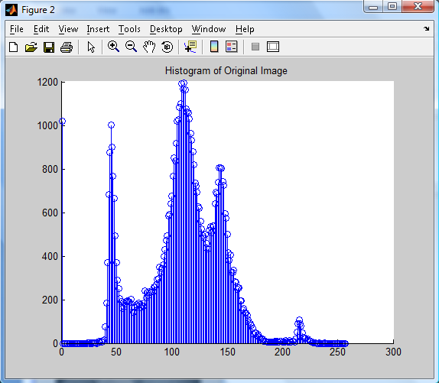
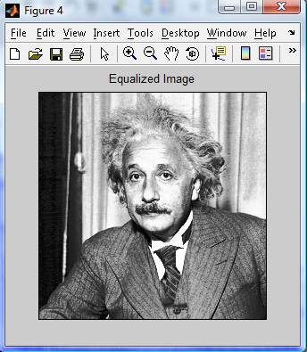
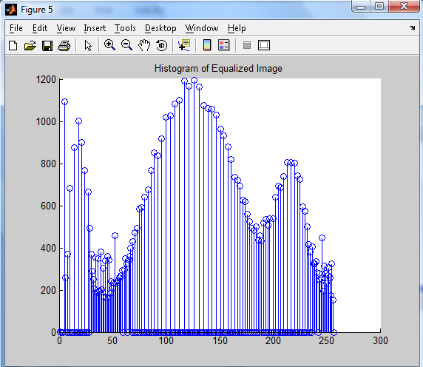
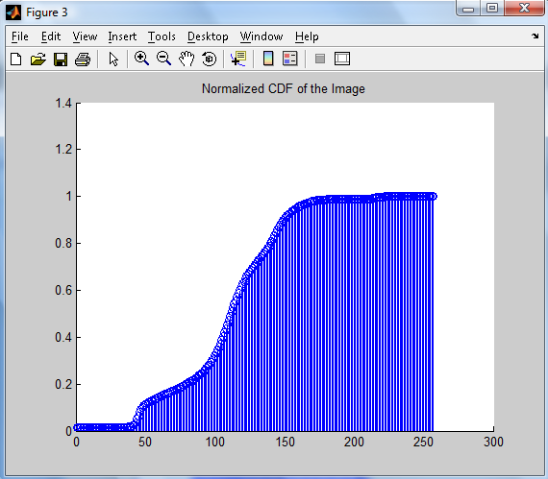

Slide 43
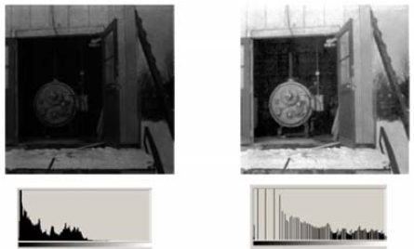
Another Example

Slide 44
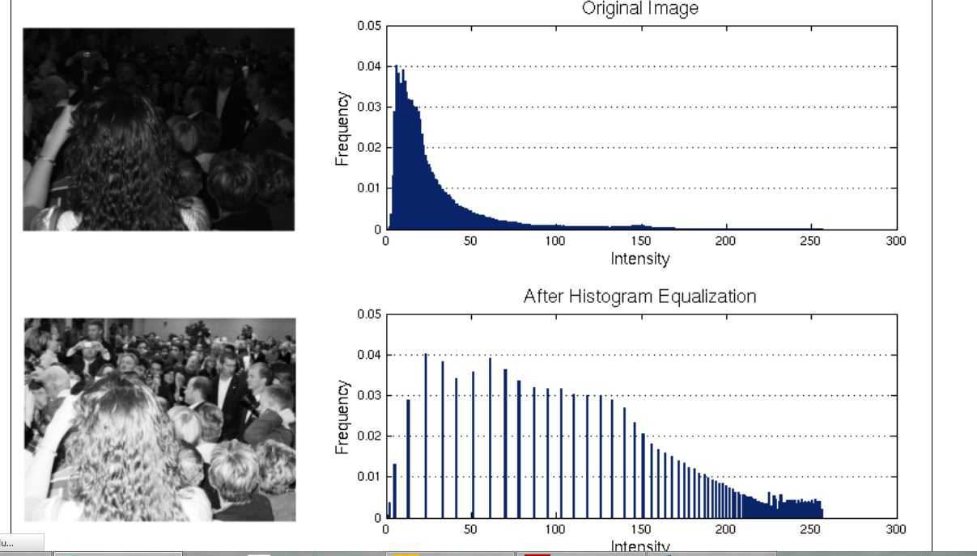
Histogram Equalization Examples

Slide 45

Histogram Equalization Examples

Slide 46
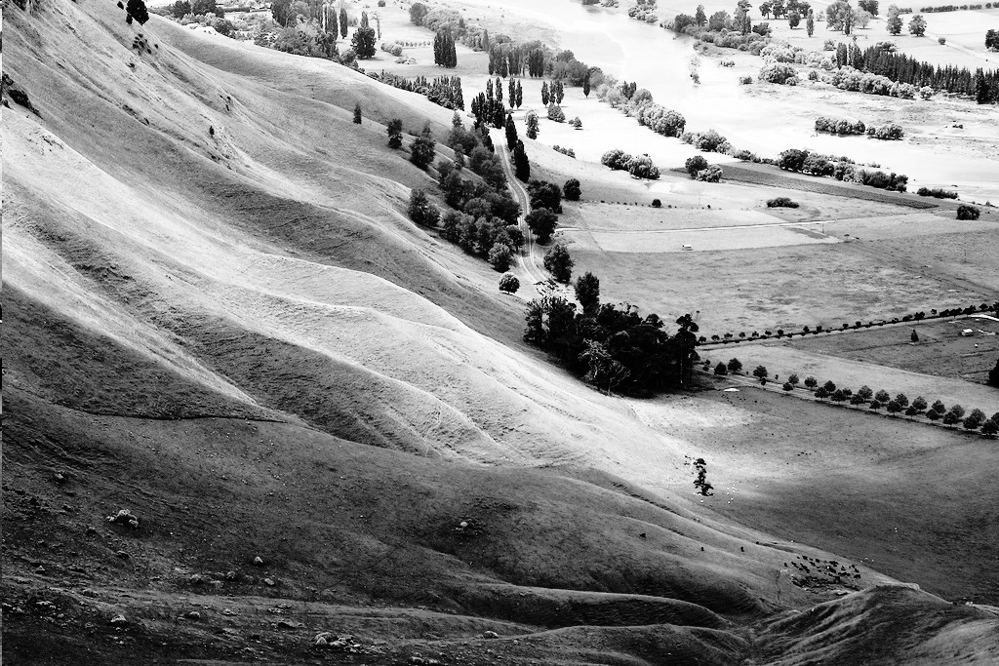
Histogram Equalization Examples

Slide 47
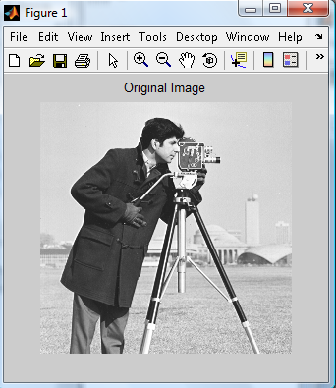
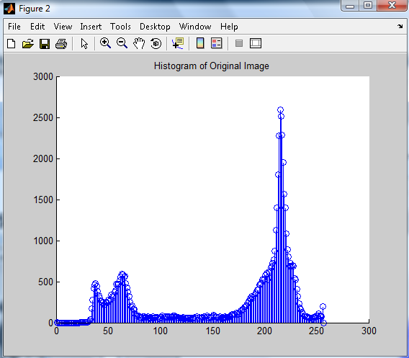
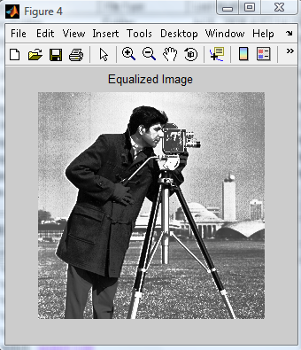
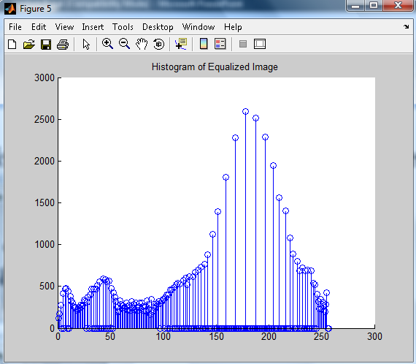
Histogram Equalization can be Worse

Slide 48
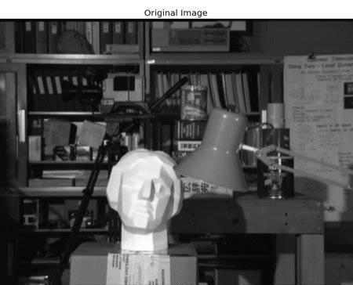
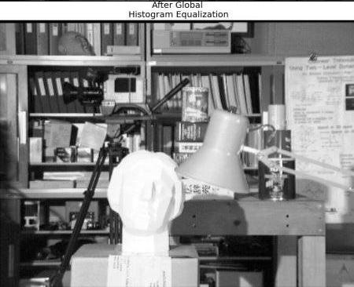
Histogram Equalization can be Worse

Slide 49
Summary
We have looked at:
Different kinds of image enhancement
Histograms
Histogram equalisation
Next time we will start to look at point processing and some neighbourhood operations

